Slide 1
CMD Automation
Project Status and Updates
Presenter Name: Leo
Date:25th Feb 2010

Slide 2
CMD Automation Project updates
CMD Automation project level
  In 9 sprints, 314 test cases with 978 prerequisites are automated.
  TVL-1 One day Campaigns, CMD 6.4 New features(TVL-0, TVL-1,TVL-2) and CMD6.5 TVL-0 test cases are completed.
CMD Automation Categories | TVL-0 | TVL-1 | TVL-2
Automated in % | 98% | 54% | 31%
Automated test cases count | 283 | 325 | 26
Automated Execution time in hours | 25 | 35 | 2
Saved manual execution time in hours | 65 | 75 | 6

Slide 3
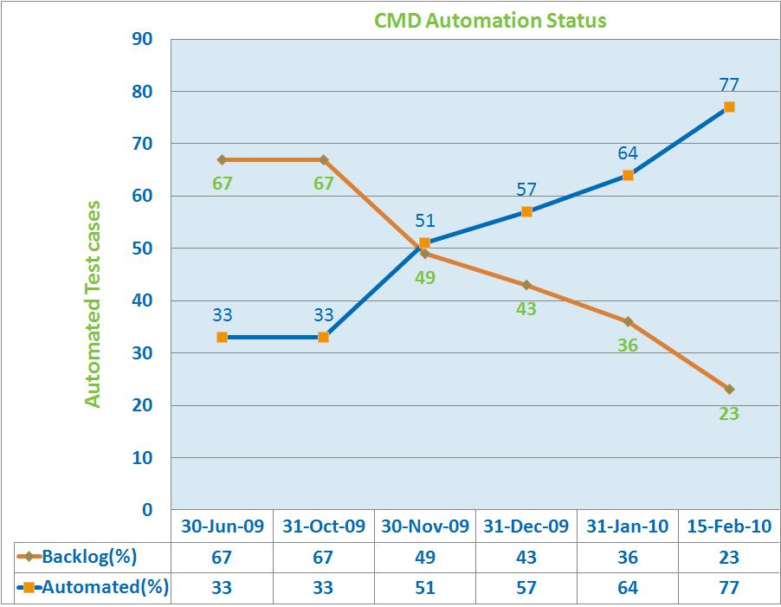
CMD Automation Project Status
Test cases categories | 30-Jul-09 | 31-Oct-09 | 30-Nov-09 | 31-Dec-09 | 31-Jan-10 | 15-Feb-10
TVL-0 | 159 | 159 | 179 | 194 | 239 | 283
TVL-1 | 161 | 161 | 308 | 317 | 325 | 325
TVL-2 | 0 | 0 | 13 | 22 | 26 | 26
Total | 320 | 320 | 500 | 533 | 590 | 634
Can't be automated | 70 | 70 | 90 | 120 | 140 | 175
Backlog | 647 | 647 | 467 | 434 | 377 | 333

Slide 4
CMD Automation Challenges
Driver Script activities.
QC-QTP Integration.
Dynamic location.
Error Recovery.
Third party control issues.
SVN Configuration.

Slide 5
CMD Automation team work
Introduction about the team
  Tasneem
  Vinay
  Mamatha
  Ritesh
Team members experience about CMD Automation activity

Slide 6
Thank You
Presenter : leo.iruthayaraj@chordiant.com

